Slide 1

“Study Now, Pay Later”
Project Presentation
MITU21BTCS0229:- Harsh Chawda
MITU21BTCS0353:- Nikhil Thorat
Guided by
Prof. Pratiksha Dhande
Department of Computer Science & Engineering, MITSoC, Loni Kalbhor

Slide 2
Outline
Introduction
Problem Statement
Objectives
Concepts & Methods
Literature Review
Identification of gaps & scope of work
Reference
Q&A
Department of Computer Science & Engineering, MITSoE, Loni Kalbhor

Slide 3
Introduction
The Study Now, Pay Later (SNPL) concept is a growing trend in education financing, particularly in secondary and higher education and co-curricular activities , designed to help students access quality education without the immediate financial burden of tuition fees , classes or course subscription , books ,course materials . It is a financial model that allows students to pursue their studies first and defer payment in the process slowly with monthly investment.
Our model also helps Students to create a Roadmap on the courses that a student should follow to complete a particular skill and its use in future according to company standards. This could done with the help of AIML techniques.

Slide 4
Problem Statement
People mostly students who want to buy Courses , Expensive Study Material , Expensive books , Class Subscriptions , College fees , Tuition fees face a lot of problem to arrange a large sum of Money at one time due to which they are not able to move forward in Academics . Students are even confused about what courses should be done to complete particular skill such as web dev, security etc.

Slide 5
Objectives
The main solution to this problem is to develop an app that is totally based on lending money to buy the required academics items and then pay it afterwards i.e either in the upcoming month or in EMI’s . This will help people to focus more on studying than bothering about money related issue at the present time.

Slide 6
Concepts & Methods
To Create a web app with various materials to study and a roadmap to follow.
To authorize user using their id proofs .
To check and sanction their limit according to their credit score or a certain sum of money can be sanctioned for person with no pan card or credit score .
OTP will be generated to check with registered number.
The user will select the service and proceed for payment option.
The payment screen will have both option for pay later , UPI ,Card etc.
OTP will be generated for confirmation of the purchase
The User will then select to the schemes of repayment available to him.
Successfully Bought screen will be shown .

Slide 7
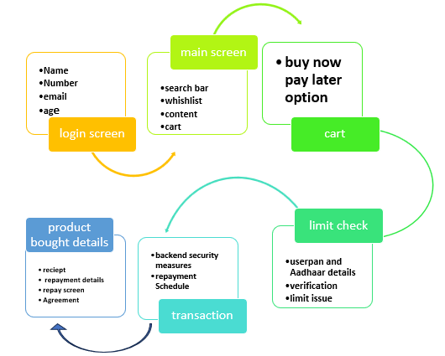
Concept and Method

Slide 8
Identification of Gaps.
There will security concern as transaction is involved.
Fake purchases of less useful materials.
Non repayment of the EMI’s,
Students not following a particular roadmap.
Sometimes noon repayment would lead to higher total amount than borrowed,
Fake personal data.
Difficulties in implementing a Roadmap as there are lot of materials available in the market, to sort them out will be a hectic task.

Slide 9
Scope of Work
It could be used in multiple platforms to Buy required study materials .
It could solve money related issue.
With age of digital learning people could adapt to new technological certificate and courses through which they can learn easily.
Bookworms could buy books.
It could help share the financial risk between the ledger and the student .It could help in collaborating with freelancer to sites for future earnings.
It a help to ease of sudden financial issue.

Slide 10
Literature Review
https://www.researchgate.net/publication/363915999_A_Research_on_Buy_Now_Pay_Later_Model_of_Amazon
https://msnim.edu.in/documents/104/BNPL_Paper-13-27.pdf

Slide 11
Reference
Based on the BNPL scheme . That is Buy Now Pay Later
It also focuses on the AIML technique to sort out a Roadmap for courses to complete to achieve a required skill.

Slide 12
Thank You

